Slide 1


Slide 2
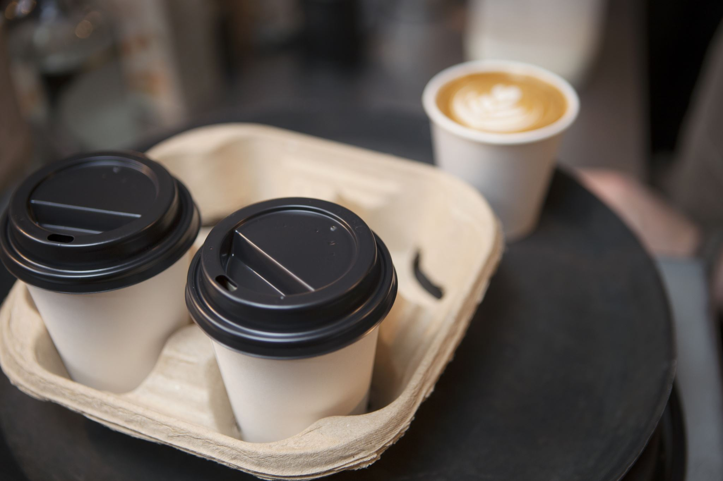
Online Food Ordering System
Supervised By
Dr Ahmed Dahroug & Eng Abdelrahman Saad
Prepared By
Saif Bakry , Omar Khaled Eldeeb , Abanoub Edwar , Ziad Tantawy

Slide 3
Agenda
Introduction
Problem definition
Objectives
Scope
Functional Requirements
Non-Functional Requirements
Context level
Zero Level
One Level
Use Case diagram
Data flow description Form
Data store description Form
Structure English
Prototype

Slide 4
Introduction
Online Ordering System can be defined as a simple and convenient way for customers to purchase food online, without having to go to the restaurant. This system is enabled by the internet – it is the internet that connects the restaurant or the food company on one hand, and the customer on other hand. Therefore, as per this system, the customer visits the restaurant’s app or website, browses through the various food items, combos and cuisines available there and goes ahead and selects and purchases the items he or she needs. These items will then be delivered to the customer at his or her doorstep at the time they choose by a delivery person. Payments for such online orders can be made through debit cards, credit cards, cash or card on delivery, or even through digital wallets. This system for online food delivery is completely safe, secure and is a very popular method that is revolutionizing the way in which the food industry operates.

Slide 5

Problem definition
Our problem for making this system is to save customer time and make facilitate the order process to make the order without any effort through the internet and pay his bills electronically .

Slide 6
Objectives
Speed up the ordering operation
More be efficient
Manual work has to be reduced
provide flexibility to customers for make order
Change or edit the order

Slide 7
Scope
The main scope in our system is to provide customers for make any food order without any effort through his device without going to any restaurant or any fast-food place to make an order and waste a lot of time during the day and make an option for the customer to cancel any order through the system and make an access for the admin to see reports about all process in the system and updating menus with new meals

Slide 8
Functional Requirements
User’s accounts
Creation user’s profile
Making order
Confirm order
View order details
Cancellation
Update profile

Slide 9
Non-Functional requirements
Performance
Our system must be with good performance to support the ordering process and to avoid any delay in our system.
Usability
Our system must be easy for using it and so efficient and must be simple to the customer for using it to do his task very quickly
Integrity
Each component in our system must be integrated with each other to be working together and doing all processes with high performance
Security
Our system must be secure because to avoid any hack about our data and the data is very important.

Slide 10
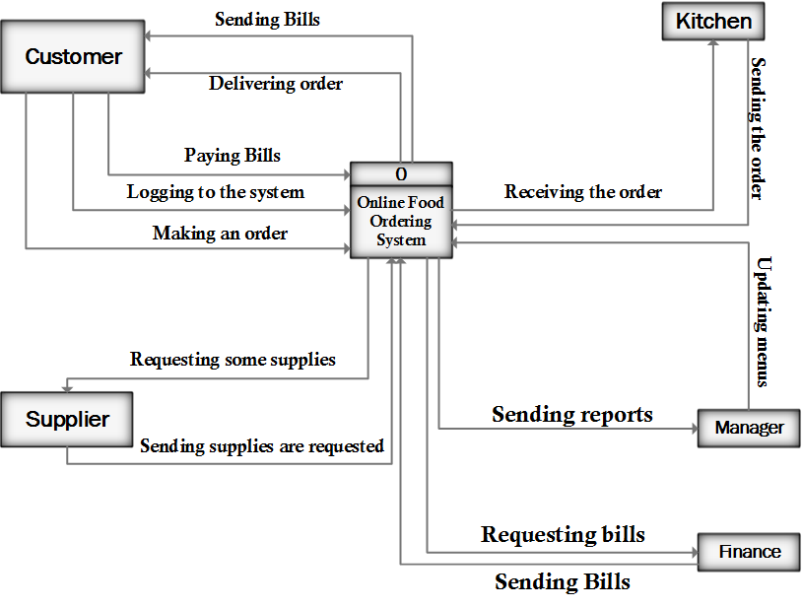
Context level

Slide 11
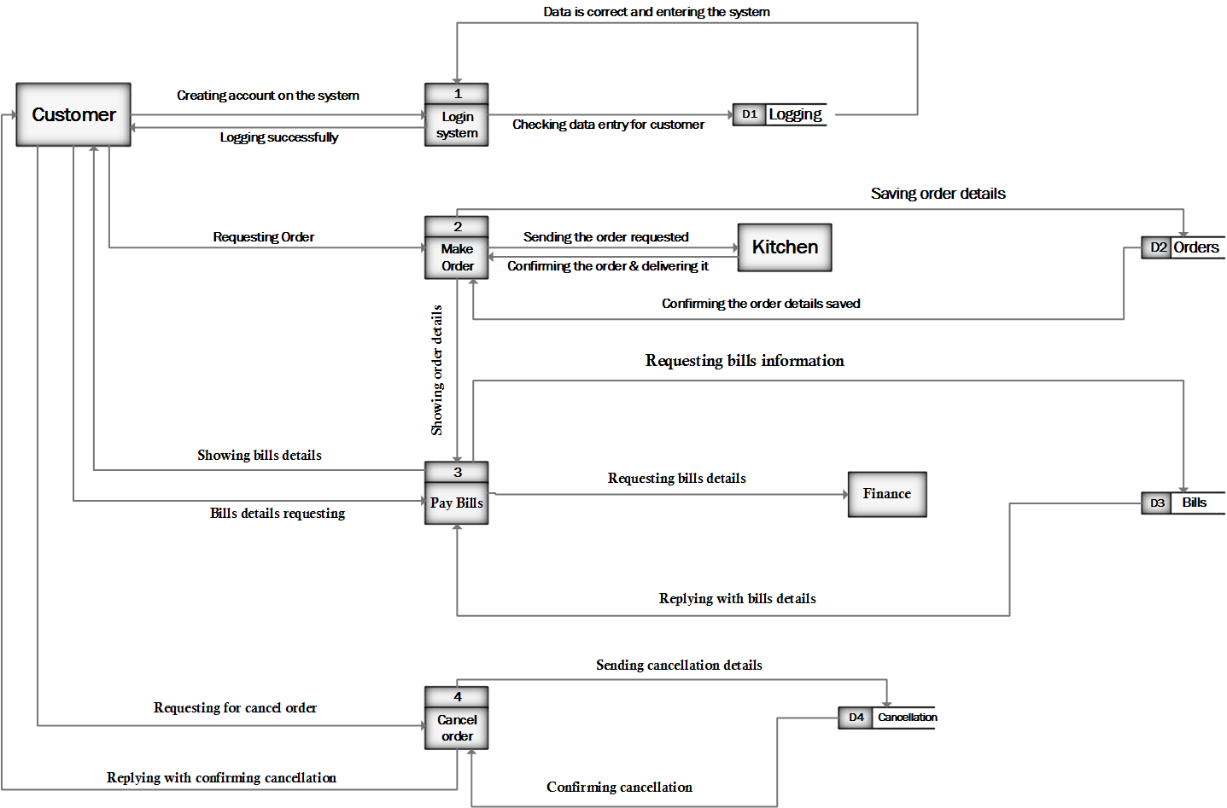
Zero Level

Slide 12
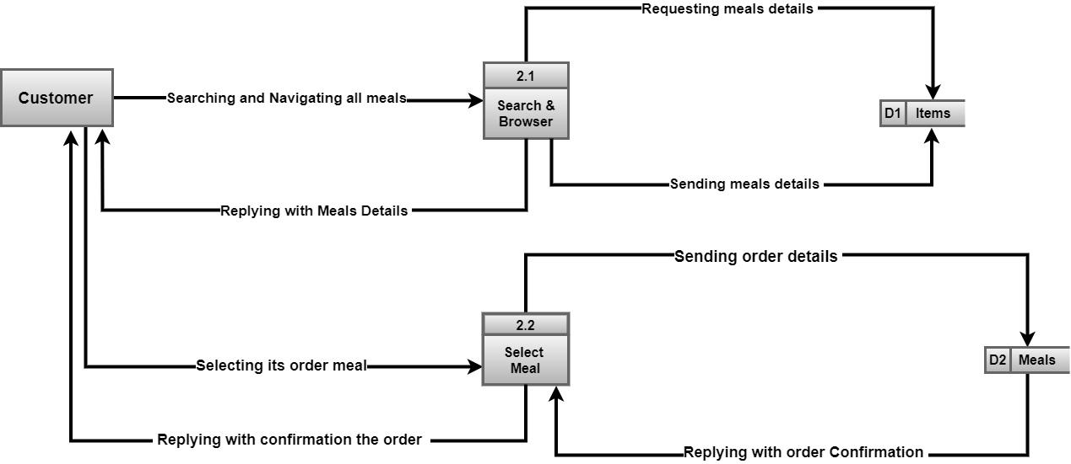
One level

Slide 13
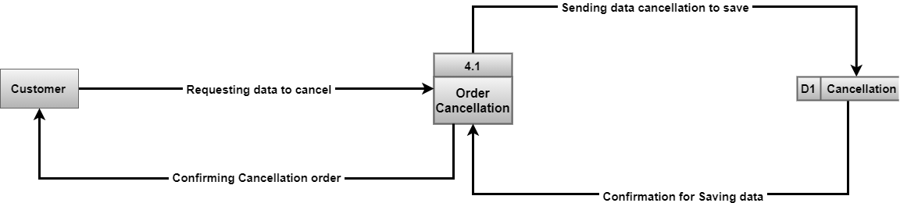
One level

Slide 14
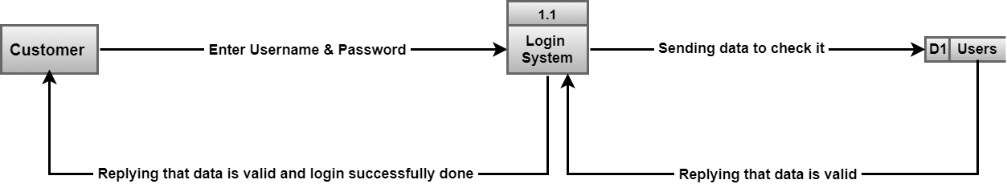
One level

Slide 15
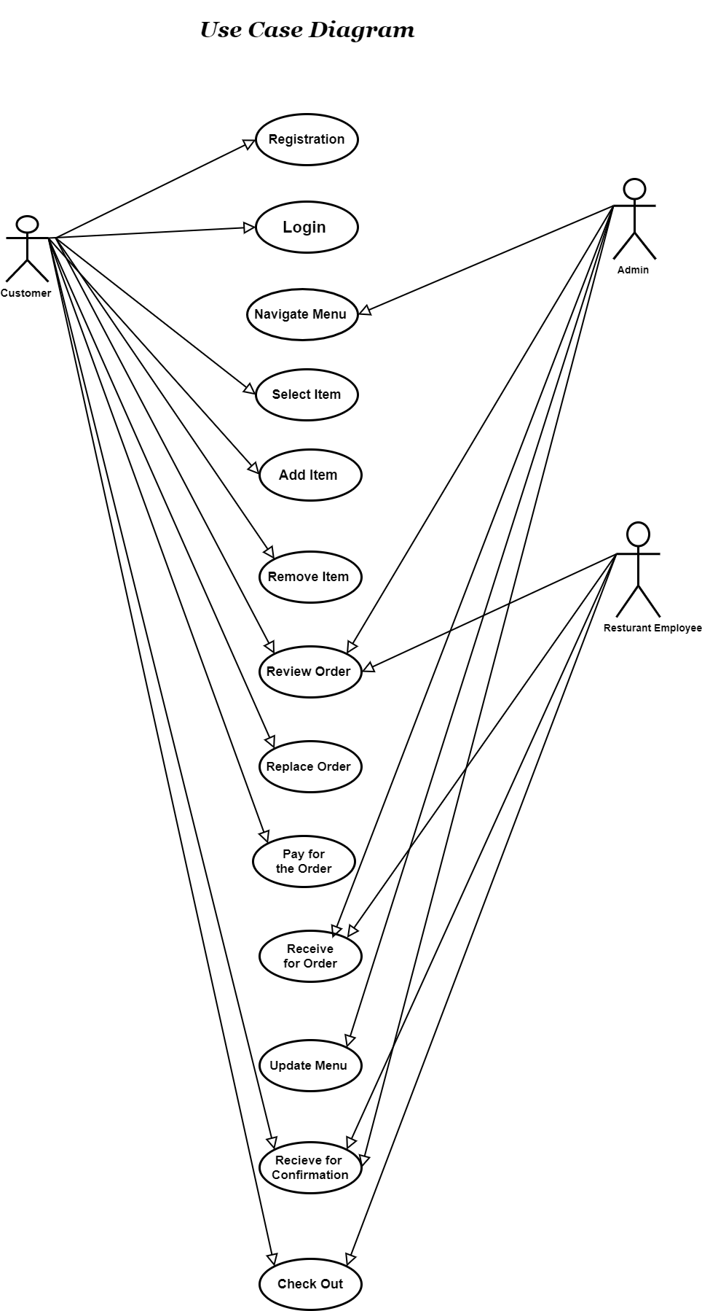
USE-CASE Diagram

Slide 16
Data Flow description form
Data Flow Description ID: 1 Name: “Order requesting” Description: it contains the order information with each details and use this information for making order
Destination: make order process | Source: Customer
Type of data Flow: File √ Screen Report Form Internal
Volume/Time: 10 KB / 1 minute | Data Structure Traveling with the Flow: “orders details”
Comments

Slide 17
Data Flow description form

Slide 18
Data Flow description form

Slide 19
Data store description Form

Slide 20
Data store description Form

Slide 21
Data store description Form

Slide 22

Structure English
1. login
IF customer has an Account
THEN
Login in the system
ELSE
Error message

Slide 23


Structure English
Search for A meal
IF customer has an Account
THEN
Search for a Meal
Then
Else IF the meal selected
THEN
Book a meal

Slide 24

Structure English
3.Payment
IF Meal is selected
THEN
Request bill details
THEN
Complete the payment

Slide 25

Structure English
4. Cancellation
IF a request for cancellation received
THEN
Cancel the order

Slide 26
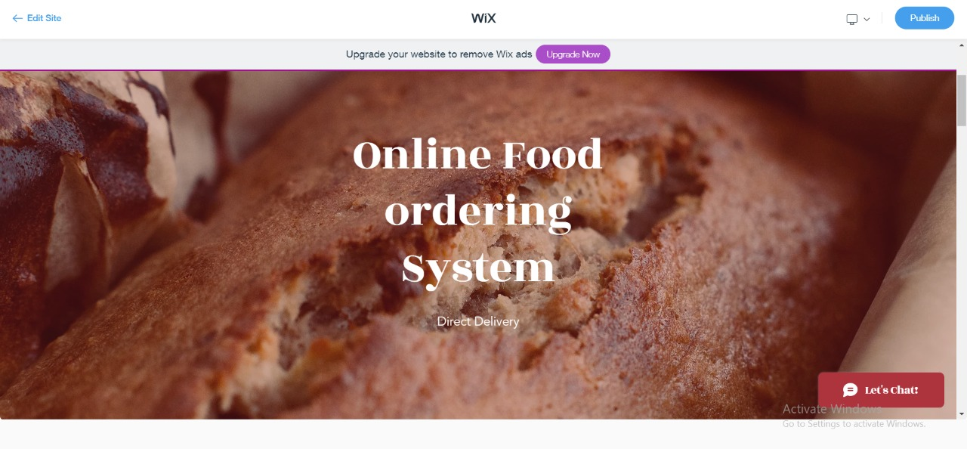
Prototype

Slide 27
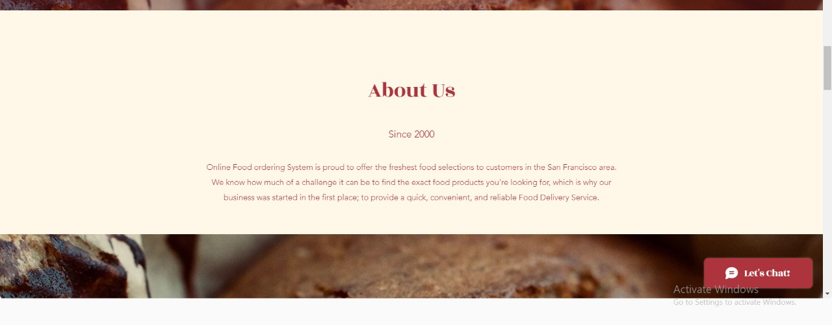
Prototype

Slide 28
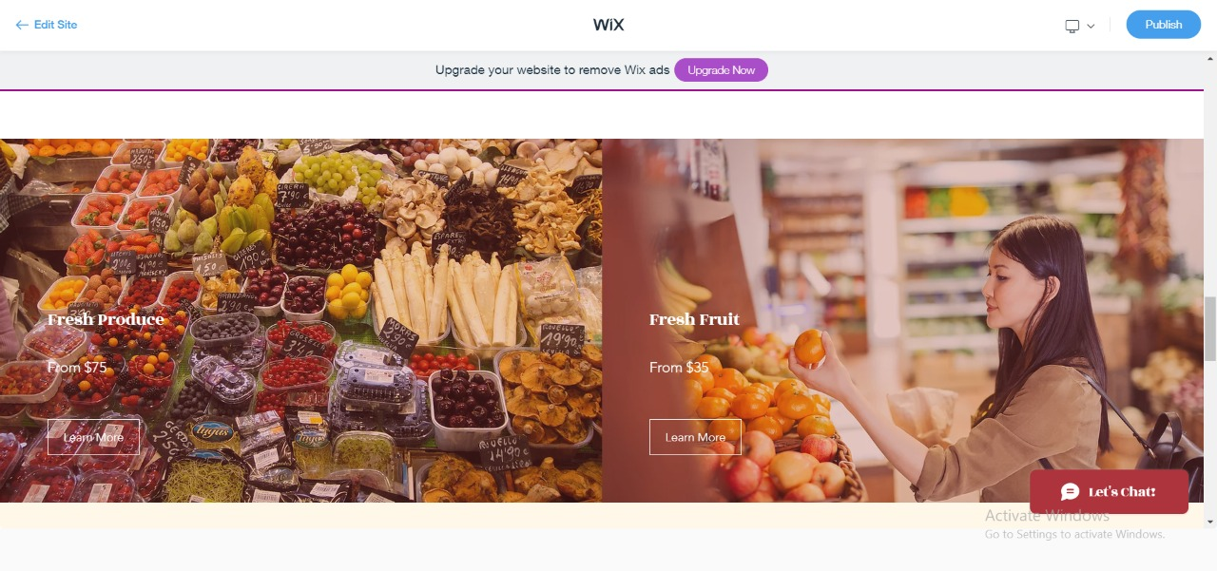
Prototype

Slide 29
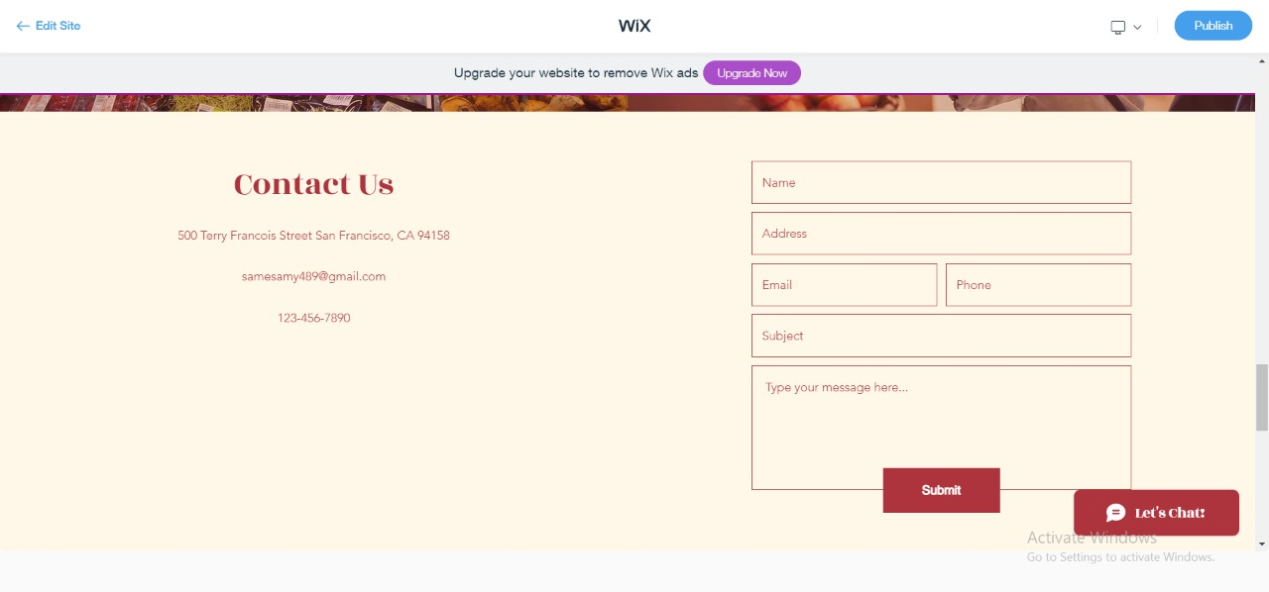
Prototype
Contact Us Form

Slide 30
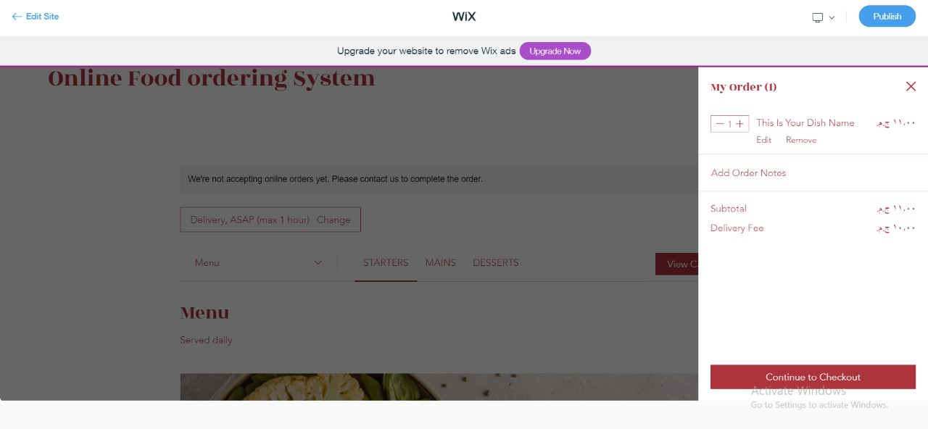
Prototype

Slide 31
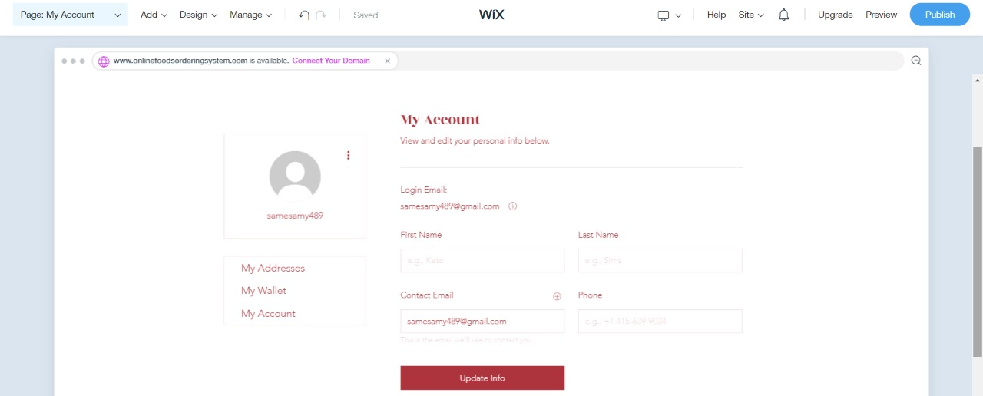
Prototype

Slide 32


Slide 33


